Slide 1
Introduction to Functions

Slide 2
Outline
Basics of functions
Pass by Value
Pass by Reference

Slide 3
Introduction to Functions
A complex problem is often easier to solve by dividing it into several smaller parts, each of which can be solved by itself.
This is called structured programming.
These parts are sometimes made into functions in C++.
main() then uses these functions to solve the original problem.

Slide 4
Advantages of Functions
Functions separate the concept (what is done) from the implementation (how it is done).
Functions make programs easier to understand.
Functions can be called several times in the same program, allowing the code to be reused.

Slide 5
C++ Functions
C++ allows the use of both internal (user-defined) and external functions.
External functions (e.g., abs, ceil, rand, sqrt, etc.) are usually grouped into specialized libraries (e.g., iostream, stdlib, math, etc.)

Slide 6
User-Defined Functions
C++ programs usually have the following form:
  // include statements
  // function prototypes
  // main() function
  // function definitions

Slide 7

Function Input and Output

Slide 8
Function Definition
A function definition has the following syntax:
<type> <function name>(<parameter list>){
<local declarations>
<sequence of statements>
}
For example: Definition of a function that computes the absolute value of an integer:
int absolute(int x){
if (x >= 0) return x;
else return -x;
}

Slide 9
Function Call
A function call has the following syntax:
<function name>(<argument list>)
  Example: int distance = absolute(-5);
  The result of a function call is a value of type <type>

Slide 10
Arguments/Parameters
one-to-one correspondence between the arguments in a function call and the parameters in the function definition.
int argument1;
double argument2;
// function call (in another function, such as main)
result = thefunctionname(argument1, argument2);
// function definition
int thefunctionname(int parameter1, double parameter2){
// Now the function can use the two parameters
// parameter1 = argument 1, parameter2 = argument2

Slide 11
Absolute Value
#include <iostream.h>
int absolute (int);// function prototype for absolute()
int main(){
int num, answer;
cout << "Enter an integer (0 to stop): ";
cin >> num;
while (num!=0){
answer = absolute(num);
cout << "The absolute value of " << num
<< " is: " << answer << endl;
cin >> num; }
return 0; }
// Define a function to take absolute value of an integer
int absolute(int x){
if (x >= 0) return x;
else return -x;
}

Slide 12
Function Prototype
The function prototype declares the input and output parameters of the function.
The function prototype has the following syntax:
  <type> <function name>(<type list>);
Example: A function that returns the absolute value of an integer is: int absolute(int);

Slide 13
Function Definition
The function definition can be placed anywhere in the program after the function prototypes.
If a function definition is placed in front of main(), there is no need to include its function prototype.

Slide 14
Absolute Value (alternative)
Note that it is possible to omit the function prototype if the function is placed before it is called.
#include <iostream.h>
int absolute(int x){
if (x >= 0) return x;
else return -x; }
int main(){
int num, answer;
cout << "Enter an integer (0 to stop): ";
cin >> num;
while (num!=0){
answer = absolute(num);
cout << "The absolute value of " << num
<< " is: " << answer << endl;
cin >> num; }
return 0; }

Slide 15
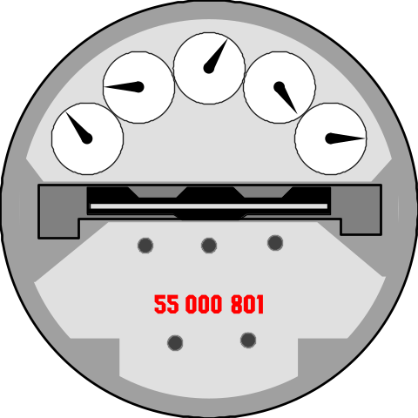
Function of three parameters
#include <iostream.h>
double total_second(int, double ,double );
int main(){
cout << total_second(1,1.5, 2) << endl;
return 0;
}
double total_second( int hour, double minutes,
double second)
{
return hour*3600 + minutes * 60 + second;
}

Slide 16
Printing the Diamond Pattern as a Function
void diamond(int size)
{
int row, space, star;
for(row=1; row<=size; row++){ //top half
for(space=1; space<=size-row; space++)
cout << " ";
for(star=1; star<=2*row-1; star++)
cout << "*";
cout << endl ;
}
for(row=size -1; row>=1; row--){ //bottom half
for(space=1; space<=size-row; space++)
cout << " ";
for(star=1; star<=2*row-1; star++)
cout << "*";
cout << endl ;
} }

Slide 17
Calculating the Area of a Circle with a Function
area?

Slide 18
Functions: Passing Parameters by Value

Slide 19

Return Value
A function normally returns a single result, if it is not a void function.
At least one of the statements in the function body should have the form:
return <expression>;
The value passed back by the return statement should have the same type as the function.

Slide 20
Pass by Value
The arguments of a function retain their original values after the function’s execution.

Slide 21
Pass by Value: Example 1
For example, consider the following code:
int sum(int num_1, int num_2){
num_1 = num_1 + num_2;
return num_1;
}
int main(){
int var_x, var_y, var_z;
var_x = 3; var_y = 5;
var_z = sum(var_x, var_y);
cout << var_z << endl;
return 0;
}
What are the values of var_x, var_y, and var_z at the end of the main() program?

Slide 22
Pass by Value: Example 1
The answer: 3, 5, and 8.
Even though the value of parameter num_1 is changed, the corresponding value in argument var_x does not change.
The value of the argument is copied to the parameter, but changes to the value of the parameter do not affect the argument.
In fact, all information in local variables declared within the function will be lost when the function terminates.

Slide 23
Pass by Value: Example 2
An example to show how the function does not affect a variable which is used as a parameter:
// Test the effect of a function
// on its parameter
#include <iostream.h>
void Increment(int Number) {
Number = Number + 1;
cout << "The parameter Number is:”<< Number << endl;
}

Slide 24
Pass by Value: Example 2
int main() {
int I = 10;
//argument is a variable
Increment(I );
cout << "The variable I is: " <<I << endl;
//argument is a constant
Increment(35);
cout << "The variable I is: " <<I<< endl;
//argument is an expression
Increment(I +26);
cout << "The variable I is: " <<I << endl;
return 0;
}

Slide 25
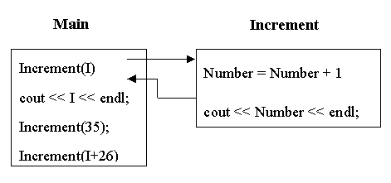
Pass by Value: Example 2

Slide 26
Pass by Value: Example 3
// Print the sum and average of two numbers
// Input: two numbers x & y
// Output: sum - the sum of x & y
// average - the average of x & y
#include <iostream.h>
void PrintSumAve ( double, double );
int main ( ) {
double x, y;
cout << "Enter two numbers: ";
cin >> x >> y;
PrintSumAve ( x , y );
return 0; }

Slide 27
Pass by Value: Example 3
void PrintSumAve (double no1, double no2)
{
double sum, average;
sum = no1 + no2;
average = sum / 2;
cout << "The sum is "
<< sum << endl;
cout << "The average is "
<< average << endl;
}

Slide 28
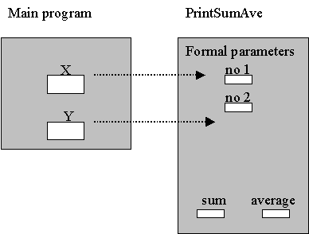
Pass by Value: Example 3
Data areas after call to PrintSumAve() :

Slide 29
Pass by Value: Example 4
//Compute new balance at a certain interest rate
//Inputs: A positive balance and
// a positive interest rate
//Output: The new balance after interest was posted
#include <iostream>
using namespace std;
double new_balance(double, double);
/* Returns the balance in a bank account after adding
interest. For example, if rate is 5.0, then the
interest rate is 5% and so new_balance(100, 5.0)
returns 105.00.
*/

Slide 30
Pass by Value: Example 4
int main(){
double interest, balance;
cout << "Enter balance (positive number): ";
cin >> balance;
if (balance <= 0.0)
cout <<"Balance not positive; stopping" << endl;
else {
cout <<"Enter interest rate (positive number): ";
cin >> interest;
if (interest <= 0.0)
cout <<"Interest not positive; stopping"<< endl;
else
cout <<"New balance = $"
<< new_balance(balance, interest)<< endl;
}
return 0;
}

Slide 31
Pass by Value: Example 4
// New balance is computed as balance +
// balance * rate/100
double new_balance(double balance, double rate) {
double interest_fraction, interest;
interest_fraction = rate / 100;
interest = interest_fraction * balance;
return (balance + interest); }

Slide 32
Pass by Value: Example 5
// Input: inches
// Output: feet and inches
#include <iostream.h>
// Function prototypes
int feet(int);
int remain_inches(int);

Slide 33
Pass by Value: Example 5
int main() {
int inches; // Number of inches
cout << "Enter number of inches to convert:";
cin >> inches;
cout << "Result is " << feet(inches)
<< " feet " << remain_inches(inches)
<< " inches" << endl;
return 0;
}
int feet(int input_inches) {
return input_inches / 12; }
int remain_inches(int input_inches) {
return input_inches % 12; }

Slide 34
Pass by Value: Example 6
// File main.cpp
// Input inches
// Output feet and inches
#include <iostream.h>
#include "i2f.h"
int main() {
int inches; // Number of inches
cout << "Enter number of inches to convert:";
cin >> inches;
cout << "Result is "<< feet(inches)<<" feet "
<< remain_inches(inches) << " inches"
<< endl;
return 0; }

Slide 35
Functions: Passing Parameters by Reference

Slide 36

Passing Parameters by Reference
To have a function with multiple outputs, we have to use pass by reference.
We use & to denote a parameter that is passed by reference:
  <type>& <variable>
  Examples:
void Increment(int& Number);
void SumAve (double, double,double&, double&);

Slide 37
Passing Parameters by Reference
The corresponding argument must be a variable.
Increment(Inc);
SumAve (2.5, y+3, sum, mean);
The address (reference) of that variable is passed to the function, instead of its value.
If the function changes the parameter value, the change will be reflected in the corresponding argument, since they share the same memory location.

Slide 38
Pass by Reference: Example 1
To show how the function affects a variable which is used as an argument:
#include <iostream.h>
void Increment(int& Number){
Number = Number + 1;
cout << "The parameter Number: "
<< Number << endl;
}
int main(){
int Inc = 10;
Increment(Inc); // parameter is a variable
cout << "The variable Inc is: "<<Inc<<endl;
return 0; }

Slide 39
Pass by Reference: Example 2
It is possible to use both pass by reference and pass by value parameters in the same function.
// Print the sum and average of two numbers
// Input: two numbers num_1 and num_2
// Output: sum of num_1 and num_2
// average of num_1 and num_2
#include <iostream.h>
void SumAve (double, double, double&, double&);

Slide 40
Pass by Reference: Example 2
int main ( ) {
double x, y, sum, mean;
cout << "Enter two numbers: ";
cin >> x >> y;
SumAve (x, y, sum, mean);
cout << "The sum is " << sum << endl;
cout << "The average is " << mean << endl;
return 0;
}
void SumAve(double no1, double no2, double& sum, double& average) {
sum = no1 + no2;
average = sum / 2; }

Slide 41
Pass by Reference: Example 3
// Compare and sort three integers
#include <iostream.h>
void swap (int&, int&);
int main ( ) {
int first, second, third;// input integers
// Read in first, second and third.
cout << "Enter three integers: ";
cin >> first >> second >> third;
if (first > second) swap (first, second);
if (second > third) swap (second, third);
if (first > second) swap (first, second);
cout << "The sorted integers are " << first
<<" , "<<second<<" , "<<third << endl;
return 0; }

Slide 42
Pass by Reference: Example 3
// Function for swapping two integers
void swap (int& num_1, int& num_2) {
int temp;
temp = num_1;
num_1 = num_2;
num_2 = temp;
}

Slide 43
Pass by Reference: Example 4
// Pass-by-reference versus pass-by-value example
#include <iostream.h>
void One (int a, int b, int& c) {
int d;
a = 10; b = 11; c = 12; d = 13;
cout<<"The values of a, b, c, and d in One:\n";
cout << a << " " << b << " " << c << " "
<< d << endl; //10 11 12 13
}
void Two (int a, int b, int& d) {
int c = 0;
cout<<"The values of a, b, c, and d in Two:\n";
cout << a << " " << b << " " << c << " "
<< d << endl; } //1 2 0 4

Slide 44
Pass by Reference: Example 4
int main () {
int a = 1, b = 2, c = 3, d = 4;
cout<<"The original values of a,b,c,and d:\n";
cout << a << " " << b << " " << c << " "
<< d << endl << endl; //1 2 3 4
One(a, b, c);
cout<<"The values of a,b,c,and d after One:\n";
cout << a << " " << b << " " << c << " "
<< d << endl; //1 2 12 4
Two(a, b, d);
cout<<"The values of a,b,c,and d after Two:\n";
cout << a << " " << b << " " << c << " "
<< d << endl; //1 2 12 4
return 0;
}

Slide 45
Pass by Reference: Example 4
Output:
The original values of a,b,c,and d:
1 2 3 4
The values of a, b, c, and d in One:
10 11 12 13
The values of a, b, c, and d after One:
1 2 12 4
The values of a, b, c, and d in two:
1 2 0 4
The values of a, b, c, and d after two:
1 2 12 4

Slide 46
Testing and Debugging Functions
One major advantage of functions is that they can be designed, coded and tested separately from the rest of the program.
Use a "driver" program to test a function with several inputs:
int main( ) {
for (int count = 1; count <= 13; count++){
diamond(count);
cout << " Calling diamond with size "
<< count <<endl;
}
return 0;
}

Slide 47
Testing and Debugging Functions
If a yet-to-be written function is needed in testing a program, replace it with a "stub" for testing.
A stub has the same interface as the original function, but not the full implementation.
Oftentimes, a stub contains just a simple return or cout command.
void diamond(int size) {
cout << " diamond is called with size "
<< size <<endl;
}

Slide 48
Example: A Simple Math Learning Tool
This example creates a program for a first grader to practice subtractions. The program randomly generates two single-digit integers number1 and number2 with number1 > number2 and displays a question such as “What is 9 – 2?” to the student, as shown in the sample output. After the student types the answer, the program displays a message to indicate whether the answer is correct.

Slide 49
Random function: rand()
#include <iostream>
#include <ctime> // for time function
#include <cstdlib> // for rand and srand functions
using namespace std;
int main()
{
// 1. Generate two random single-digit integers
srand(time(0));
int number1 = rand() % 10;
int number2 = rand() % 10;
// 2. If number1 < number2, swap number1 with number2
if (number1 < number2)
{
int temp = number1;
number1 = number2;
number2 = temp;
}

Slide 50
Random function: rand()
// 3. Prompt the student to answer
cout << "What is " << number1 << " - " << number2 << "? ";
int answer;
cin >> answer;
// 4. Grade the answer and display the result
if (number1 - number2 == answer)
cout << "You are correct!";
else
cout << "Your answer is wrong.\n" << number1 << " - " << number2
<< " should be " << (number1 - number2) << endl;
return 0;
}

Slide 51
Generating Random Characters
Computer programs process numerical data and characters. You have seen many examples that involve numerical data. It is also important to understand characters and how to process them.
Since every character has a unique ASCII code between 0 and 127. To generate a random character is to generate a random integer between 0 and 127. We already learn how to generate random number from last example. Basically it is to use the srand(seed) function to set a seed and use rand() to return a random integer. You can use it to write a simple expression to generate random numbers in any range. For example,

Slide 52
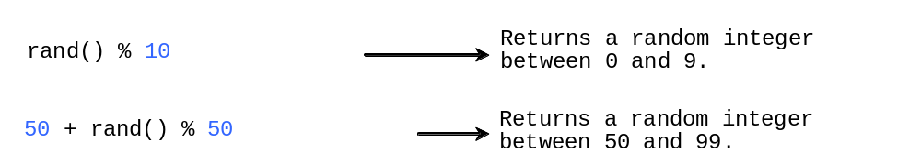
Case Study: Generating Random Characters,

Slide 53
Random function: rand()
#include <iostream>
#include <cstdlib>
#include <ctime>
using namespace std;
// Generate a random character between ch1 and ch2
char getRandomCharacter(char ch1, char ch2)
{ return static_cast<char>(ch1 + rand() % (ch2 - ch1 + 1));}
// Generate a random lowercase letter
char getRandomLowerCaseLetter()
{ return getRandomCharacter('a', 'z');}
// Generate a random uppercase letter
char getRandomUpperCaseLetter()
{ return getRandomCharacter('A', 'Z');}
// Generate a random digit character
char getRandomDigitCharacter()
{ return getRandomCharacter('0', '9');}
// Generate a random character
char getRandomCharacter()
{ return getRandomCharacter(0, 127);}

Slide 54
Random function: rand()
int main()
{
const int NUMBER_OF_CHARS = 175;
const int CHARS_PER_LINE = 25;
srand(time(0)); // Set a new seed for random function
// Print random characters between '!' and '~', 25 chars per line
for (int i = 0; i < NUMBER_OF_CHARS; i++)
{
char ch = getRandomLowerCaseLetter();
if ((i + 1) % CHARS_PER_LINE == 0)
cout << ch << endl;
else
cout << ch;
}
return 0;}

